Slide 1
Analysing U.S. Landfill Gas-to-Energy Projects: Trends, Performance, and Environmental Impact
Carried out by: Akintola Caleb Damilola
18TH MAY, 2025

Slide 2
Table of Content
Overview
What is the goal of this project?
What are the key questions to be answered?
Data Sourcing
Key Insights

Slide 3
Overview
Landfill Gas-to-Energy (GTE) projects are environmental and energy initiatives that capture methane-rich gas produced from the natural decomposition of organic waste in landfills and convert it into usable forms of energy.
Methane is a potent greenhouse gas, more than 25 times more effective than carbon dioxide at trapping heat in the atmosphere over 100 years. If left uncontrolled, this gas escapes into the atmosphere and contributes significantly to climate change.

Slide 4
Overview
To address this, many landfill facilities across the United States have adopted gas collection systems that capture this methane before it escapes. Once collected, the gas can be processed and used to generate electricity, fuel industrial operations, or even be upgraded to pipeline-quality renewable natural gas (RNG).
These projects serve two primary purposes:
1. Environmental Protection
2. Energy Generation

Slide 5
What is the goal of this project?
The main goal of this project is to gain a deeper understanding of how landfill projects are distributed across states, assess their energy performance, and identify key drivers behind their effectiveness.
This analysis is important for several reasons:
Climate Change Mitigation
Policy and Infrastructure Planning
Promoting Renewable Energy Growth

Slide 6
What are the key questions to be answered?
The key questions to be answered are:
1. How are landfills and their gas recovery projects distributed across the U.S., and what patterns emerge across states or ownership types?
2. What are the key physical and operational characteristics of U.S. landfills?
3. What is the scale and nature of landfill gas-to-energy projects?
4. How much methane is recovered, used, or flared, and what is the environmental benefit of these efforts?
5. What factors influence project efficiency and landfill performance?

Slide 7
Data Sourcing
The dataset used for this project provides comprehensive information on landfill gas-to-energy (GTE) projects across the United States. It was sourced from the Kaggle platform and can be traced to information from the U.S. Environmental Protection Agency (EPA).

Slide 8
KEY INSIGHTS

Slide 9
Key Metrics
There were originally 873 unique projects whose details were contained in the dataset, but upon cleaning, it was scaled down to 576 projects, each covering different states across the country. There are 328 privately owned landfill gas-to-energy facilities and 248 publicly owned ones.
Sixty-four (64) of these projects are in California, with 58 others in Michigan. Many states can boast of only one such project. Each facility's average waste in place (in tons) is 16761111.87. The minimum value of this is 534000 tons.
Public-owned facilities generate a combined 668 MW, and Private facilities, 1106 MW

Slide 10
Key Metrics
A total of 447 of these projects are intended for use by Reciprocating Engines, 55 for cogeneration, 46 for steam turbines, 10 for microturbines, 8 for combined cycle, 7 for steam turbines, 2 for Stirling cycle engines, and one for electricity.
The average age of each landfill is 17 years, with the oldest of them being 43 years. The estimated energy generated from these projects is 1794.401 MW, and a direct emissions reduction of 63.65 mmtco2/yr.

Slide 11
Key Metrics
Of the total estimated capacity, the current energy generation stands at 1353.232 MW, as 436.369 MW of energy was originally due to facilities that have now been shut down, 3.2 MW is due to 2 facilities in the construction phase, and 1.6 MW is due to a facility in the planned phase.

Slide 12
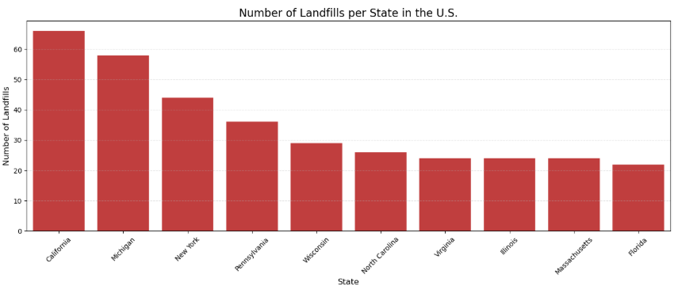
Geographic analysis
The landfills are distributed unevenly across states, with some states like California, Michigan, and New York having the highest concentrations. A bar chart was used to visualise the top 15 states with the most landfill projects.

Slide 13
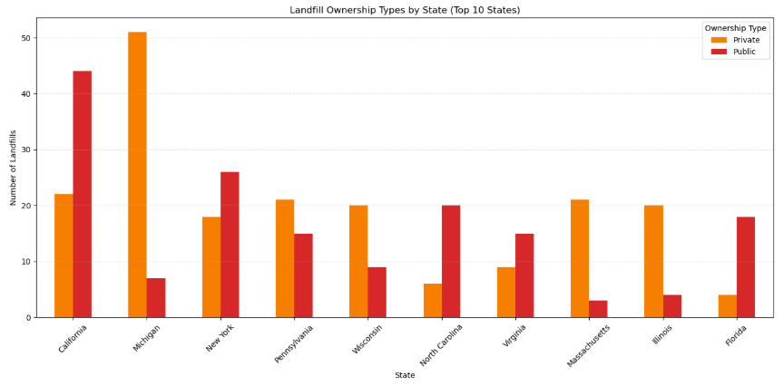
Geographic analysis
Analysis revealed the ownership structure of landfills in different states. States like Michigan, Pennsylvania, Wisconsin, Massachusetts, and Illinois have more privately owned facilities than pubic.

Slide 14
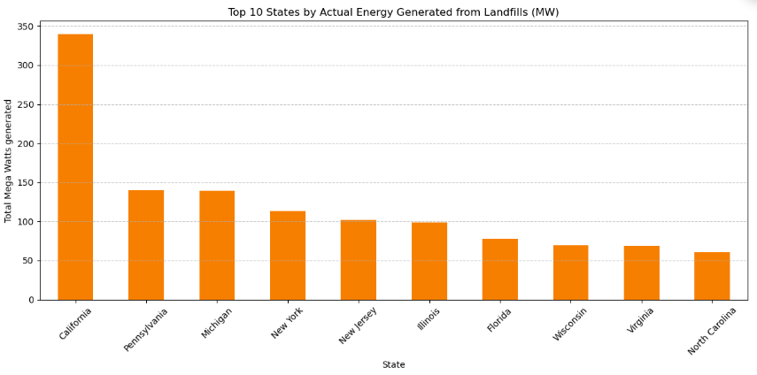
Energy Potential
The energy generation potential varies significantly by state. States with a higher number of landfill projects generally produce more energy, though this trend isn't perfectly linear. California, Pennsylvania, and Michigan emerged as top contributors to energy generation.

Slide 15
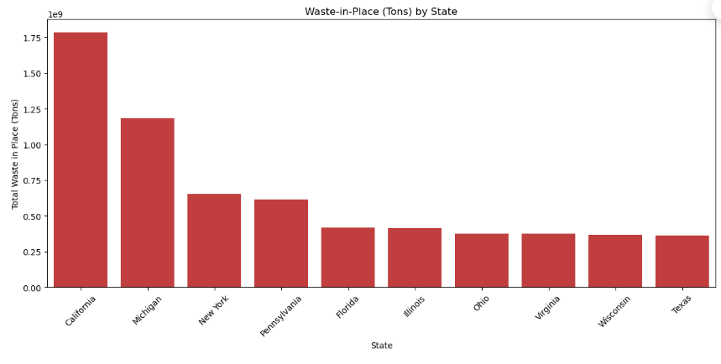
Waste Potential
Analysis revealed the value of waste in place (tons) for different states. This analysis was compared with the energy generation of states to determine states with high conversion rates of waste. States like California, Michigan, New York and Pennsylvania showed a high conversion rate. States like Florida, Ohio, and Texas showed a low conversion rate.

Slide 16
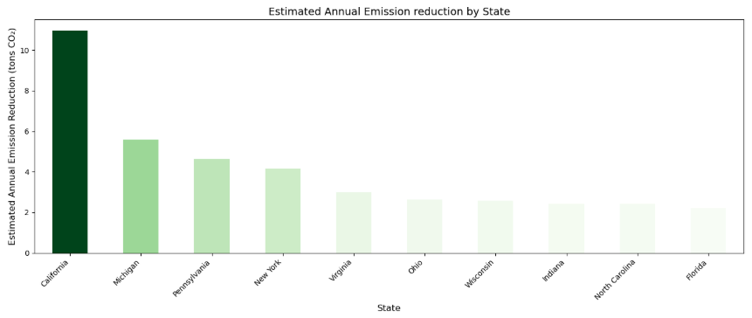
Emission Reduction
States with high energy output also tend to have high emission reductions, though this relationship might vary based on gas capture and utilisation efficiencies.

Slide 17
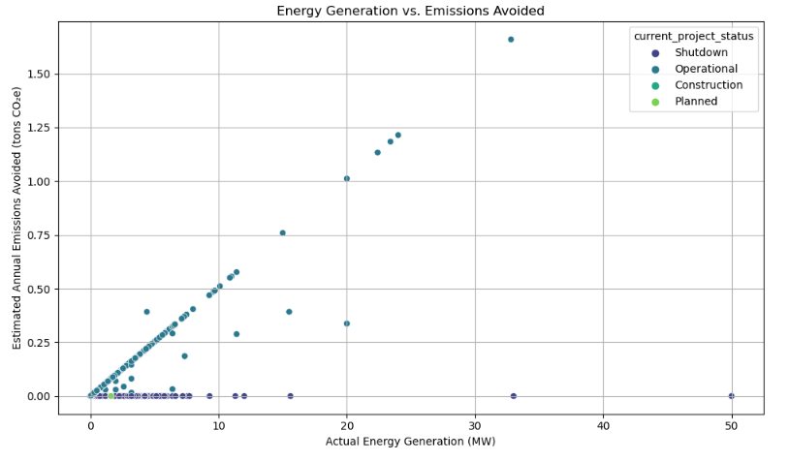
Correlation Analysis
A correlation analysis showed a strong positive relationship between:
Gas captured and energy generated, and
Energy generated and emissions avoided
There is a 0.64 correlation between energy generated and direct emissions reduced.

Slide 18
Correlation Analysis
A correlation analysis showed a strong positive relationship between:
Gas captured and energy generated, and
Energy generated and emissions avoided
There is a 0.64 correlation between energy generated and direct emissions reduced.

Slide 19
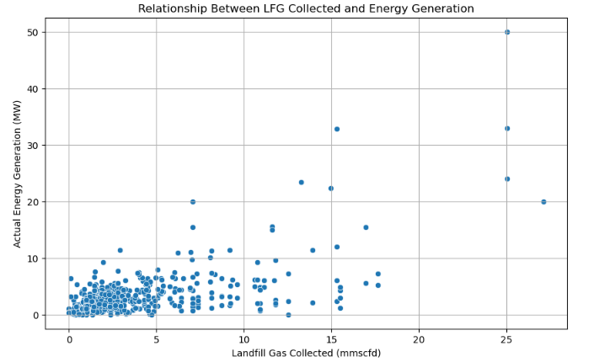
Correlation Analysis
There is a 0.64 correlation between the LFG gas collected and the energy generated. This reveals that in some cases, the gas capacity of the landfill is not used entirely to get energy.

Slide 20
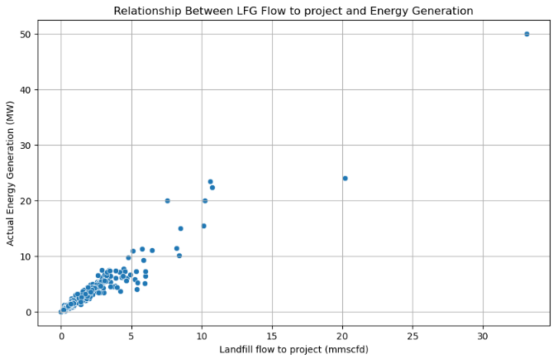
Correlation Analysis
As expected, there is a 0.96 correlation between the LFG gas flow to the project and energy generation.

Slide 21
RECOMMENDATIONS
1. Prioritise States with Untapped Potential
States with a high number of landfill sites but low energy generation outputs should be evaluated for the underutilization of gas resources.
2. Enhance Gas Collection Systems
Improving gas collection efficiency directly translates to higher energy yields.
3. Adopt Emissions-Based Incentives
States that contribute significantly to emissions but generate less energy from LFG should be targeted for emission-reduction programs.

Slide 22
RECOMMENDATIONS
4. Prioritise States with Untapped Potential
States with a high amount of landfill waste but low energy generation outputs should be evaluated for the underutilization of resources. Targeted investment and technical audits should be conducted to identify bottlenecks such as ageing infrastructure, inefficient collection systems, or regulatory delays.

Slide 23
THANK YOU

